Slide 1

CRICKET FEVER

Slide 2

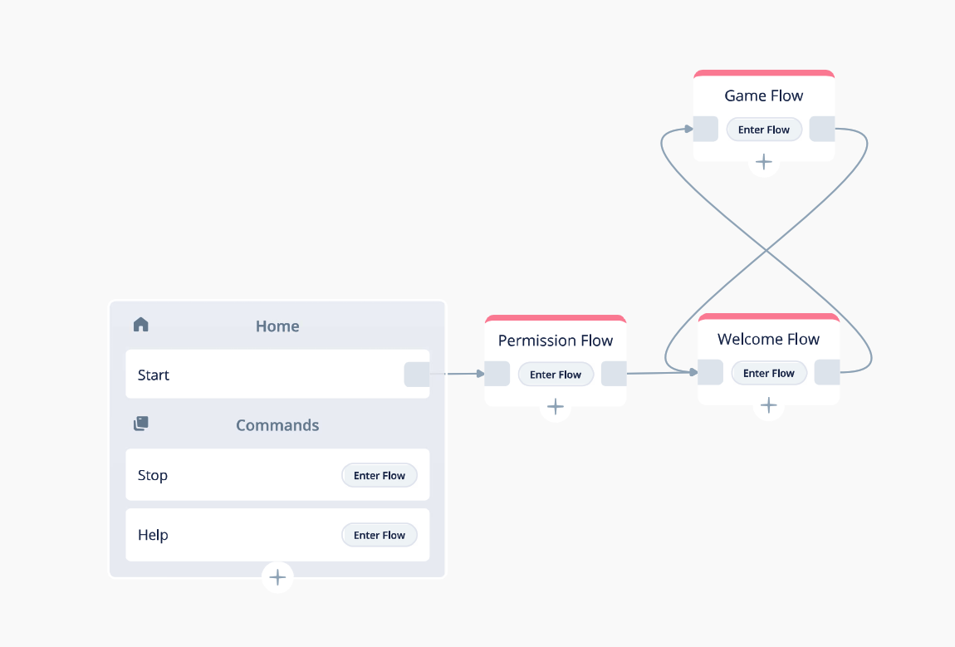
Main Flow

Slide 3
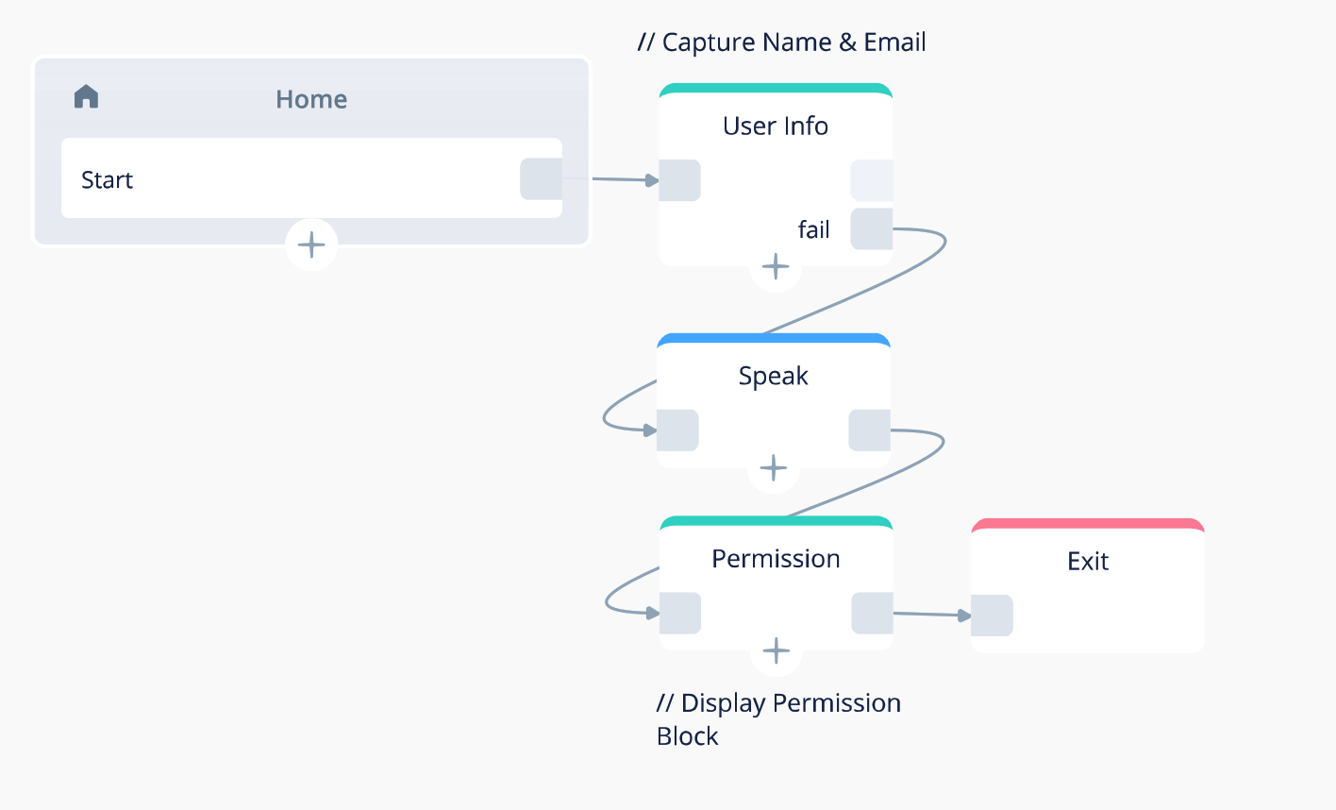
Permission Flow

Slide 4
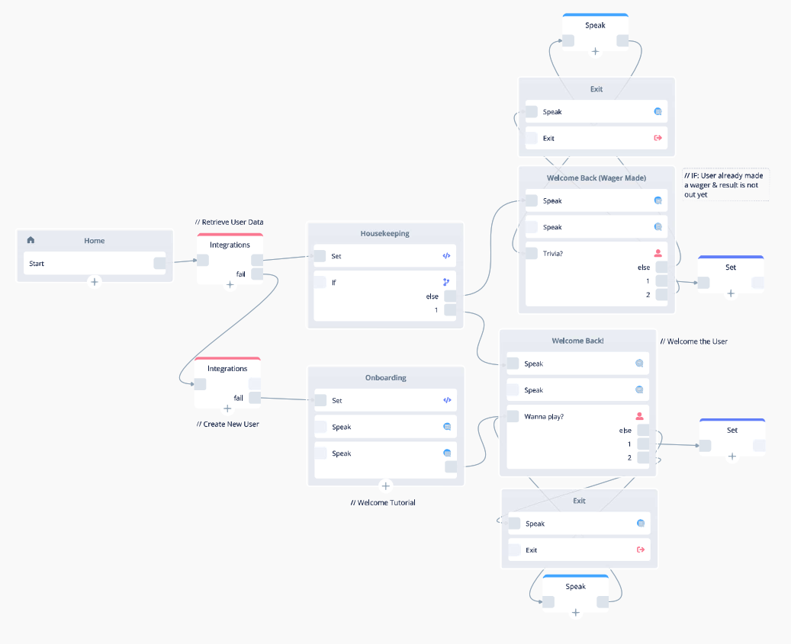
Welcome Flow

Slide 5
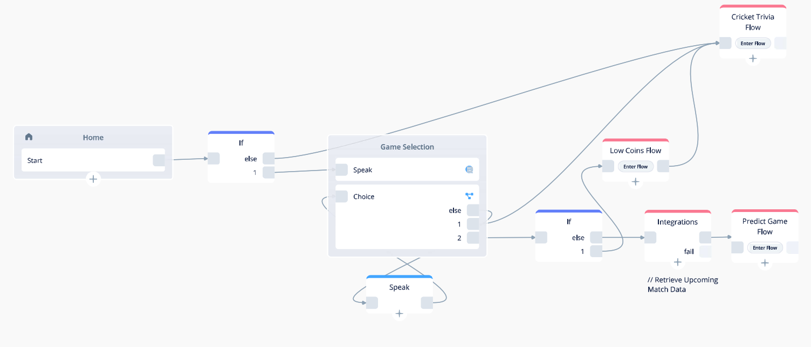
Game Flow

Slide 6
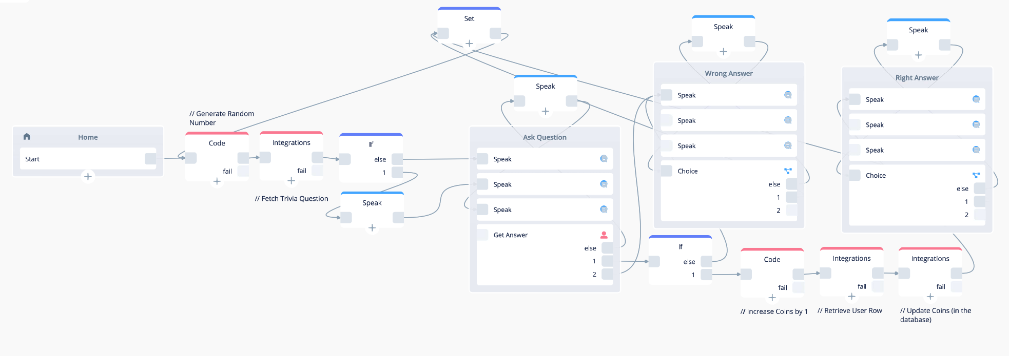
Cricket Trivia Flow

Slide 7
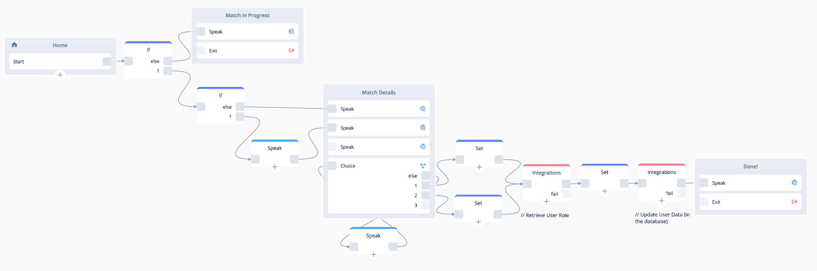
Predict Match Flow

Slide 8
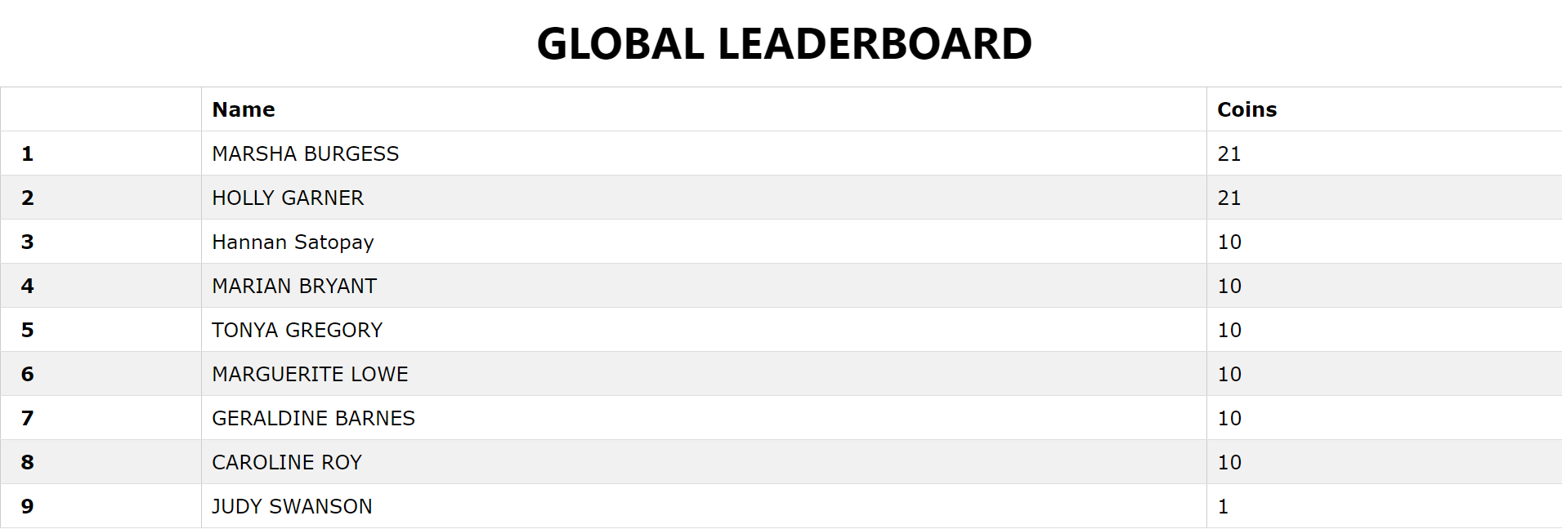
Global Leaderboard

Slide 9

THANK YOU

